Slide 1
Applying Information-Centric Networking in Today’s Agriculture
Pilaiwan Phupattanasin, Sheau-Ru Tong
National Pingtung University of Science and Technology
Taiwan R.O.C.

Slide 2
Introduction

Slide 3
Sharing Contents
Server/Client
Peer-to-Peer
Information Centric Networking (ICN)
Agriculture Structure Change

Slide 4
ICN Communication

Slide 5
Content advertisements
Subscriptions
Content delivery paths
Caching Content
Content provider
(publisher)
Subscriber
Subscriber
A
Trustable copy of object B
C
E
B
D
Get object B
E
B
B
B
D
C
A
A
C
E
C
A
Untrusted connection
Untrusted host

Slide 6
ICN Model

Slide 8
A Real Scenario on Mobile Device

Slide 10
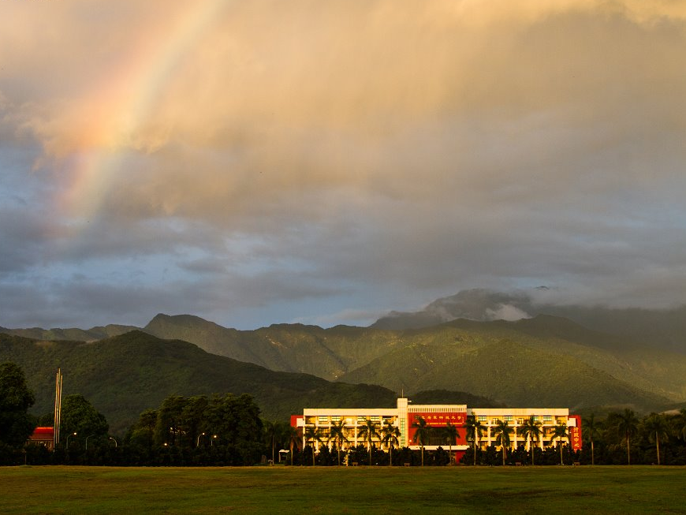
Acknowledgement
National Pingtung University of Science and Technology
CAAS 2013’s Reviewers
Meajo University
@
Cape Panwa Hotel, Phuket, Thailand
Date
November 23-24, 2013

